Slide 1
Teach2Give Leadership Retreat
Devotions

Slide 3
Life Looks Random
What Puzzle Are You Solving?
Whose Assistance Do You Seek?
How Is Success Defined?

Slide 4
Confidence
What?
When?
Why?

Slide 5
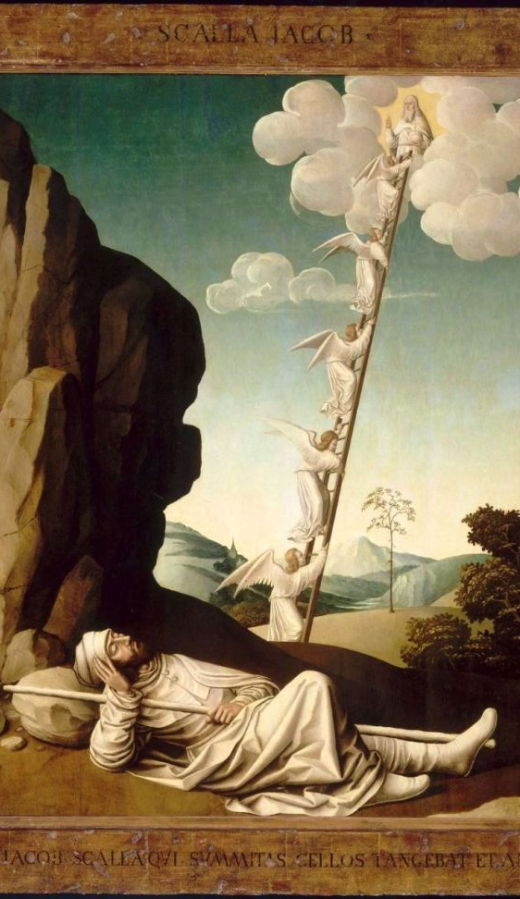
Genesis 28 – Jacob’s Ladder
Genesis 28
13 There above it stood the Lord, and he said: “I am the Lord, the God of your father Abraham and the God of Isaac. I will give you and your descendants the land on which you are lying. 14 Your descendants will be like the dust of the earth, and you will spread out to the west and to the east, to the north and to the south. All peoples on earth will be blessed through you and your offspring. 15 I am with you and will watch over you wherever you go, and I will bring you back to this land. I will not leave you until I have done what I have promised you.”

Slide 6
Joshua Charged With The Impossible
Joshua 1
⁷ “Be strong and very courageous. Be careful to obey all the law my servant Moses gave you; do not turn from it to the right or to the left, that you may be successful wherever you go. ⁸ Keep this Book of the Law always on your lips; meditate on it day and night, so that you may be careful to do everything written in it. Then you will be prosperous and successful. ⁹ Have I not commanded you? Be strong and courageous. Do not be afraid; do not be discouraged, for the Lord your God will be with you wherever you go.”

Slide 7
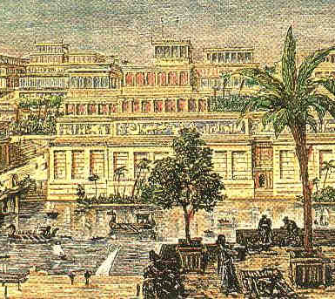
Jeremiah 29
⁵ “Build houses and settle down; plant gardens and eat what they produce. ⁶ Marry and have sons and daughters; find wives for your sons and give your daughters in marriage, so that they too may have sons and daughters. Increase in number there; do not decrease. ⁷ Also, seek the peace and prosperity of the city to which I have carried you into exile. Pray to the Lord for it, because if it prospers, you too will prosper.”
¹⁰ This is what the Lord says: “When seventy years are completed for Babylon, I will come to you and fulfill my good promise to bring you back to this place.
Individual – Family - Community

Slide 8
Great Commission Matthew 29
¹⁸ Then Jesus came to them and said, “All authority in heaven and on earth has been given to me. ¹⁹ Therefore go and make disciples of all nations, baptizing them in the name of the Father and of the Son and of the Holy Spirit, ²⁰ and teaching them to obey everything I have commanded you. And surely I am with you always, to the very end of the age.”

Slide 9
Whose Plan Are You Seeking
Examine Mission
Expect Setbacks
Experience Christ’s Presence
Expect Victory

