Slide 1
Teach2Give Leadership Retreat
January 4-5, 2024

Slide 2
Welcome
All Documents – teach2give.com
Participation, Interactive
Be on Time
Have Fun

Slide 3
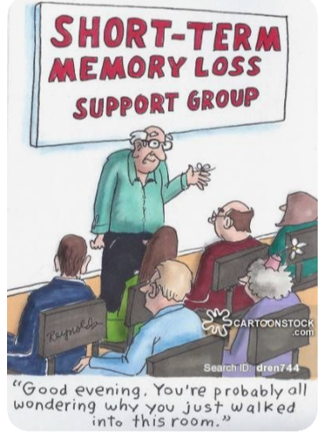
Why Are You Here?
Leadership Believes in YOU
To Raise Up Kenyan Leaders
What We Are Asking From You

Slide 4
Compound Effect
10 Universities
Multiple Curricula
We need 25 Mentors
2 cohort students
Once/2 weeks, 12 weeks
Continue Being Mentored

Slide 5
Raise Up Kenyan Leaders
Part of Mission
Develop Core Competencies
Kenyans Leading Kenyans
Rewards

Slide 6
Enjoy Mentorship
Rewarding
Opportunity To Give Back
Something Larger

Slide 9
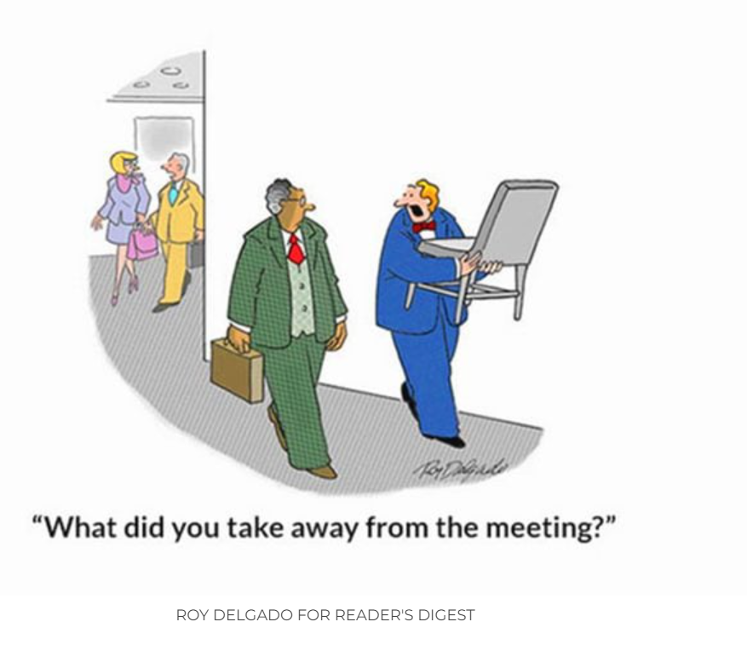

Slide 10
Group Exercise
Qualities of a Mentor
List qualities you’ve experienced
List qualities you possess
List qualities you want to develop

Slide 11
Mentor QUALITIES
GOOD
POOR
Want to help others
Good communication
Leads others to find answers vs just telling them
Recognizes the value of mentorship for both mentee and mentor
Gives honest and candid feedback
Ask great questions
Shares knowledge/ experience
Withholds judgment-
Seeks to understand
Understands the power of relationships
Invests in people around them
Self focused
Lacks giving encouragement
Unreliable
Poor listener- dominates the conversation
Won’t admit to weakness
No boundaries
Shares too much
Unhelpful advice
No sense of humor

Slide 12
Mentoring provides
Demonstrate your leadership skills
Take delight in helping others
Become exposed to different thoughts and ideas
Enhance your professional network
Develops your own knowledge and keeps you sharp
Helps you set goals
Become better listener- better communicator
Become a trusted ally
Sounding board
Solid advice
Encouragement in your life
Gives different perspectives
Provides perspective on who mentees are-
share at a deeper relationship
Give views of hidden talents and abilities
Their questions help grow and challenge to build traits and abilities

Slide 13
Mentorship skills are transferable
How can you apply what you’ve learned and do as a mentor?
What can you review with your mentor?

Slide 14
Assignment-Gratitude
Write an email to Matt and Dan and your manager at Griffin
Thank them for believing in you.
Thank them for investing in you, your family and Kenya
Take selfie while you are here - thank them for paying for this outing and tell them what it means to you.

Slide 15
Assignment- Gratitude
To Those Who Mentored You
write an email to your mentor.
Thank them for believing in you
Thank them for the time they have invested.
Tell them how they impacted you and your family -- show them the evidence that together we are achieving our mission
Include a selfie of you having a good time at this retreat

Slide 16
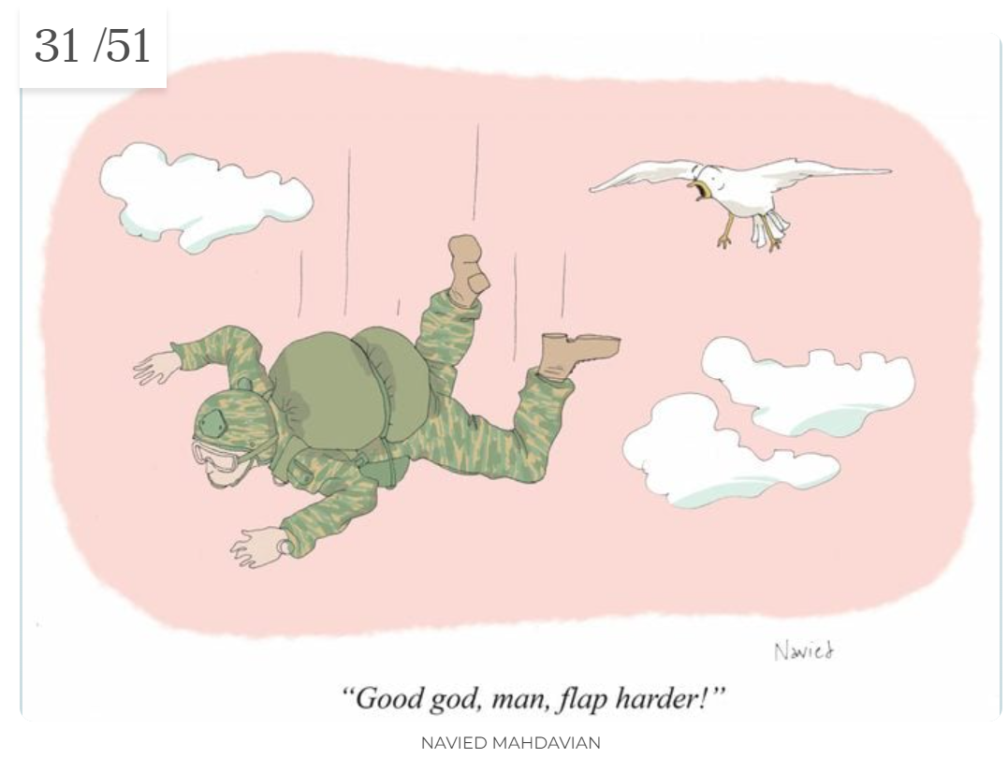

Slide 17
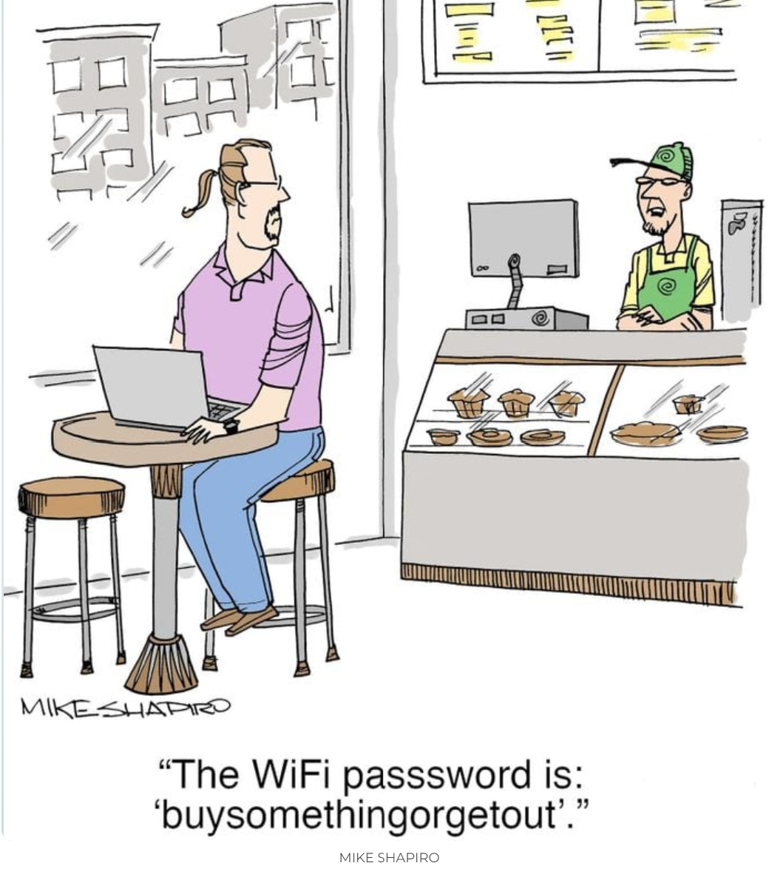

Slide 19
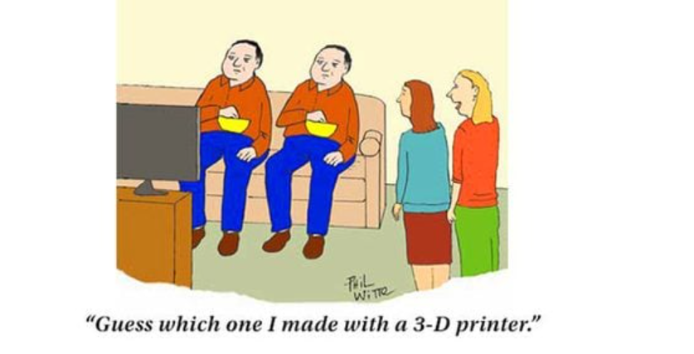

Slide 20
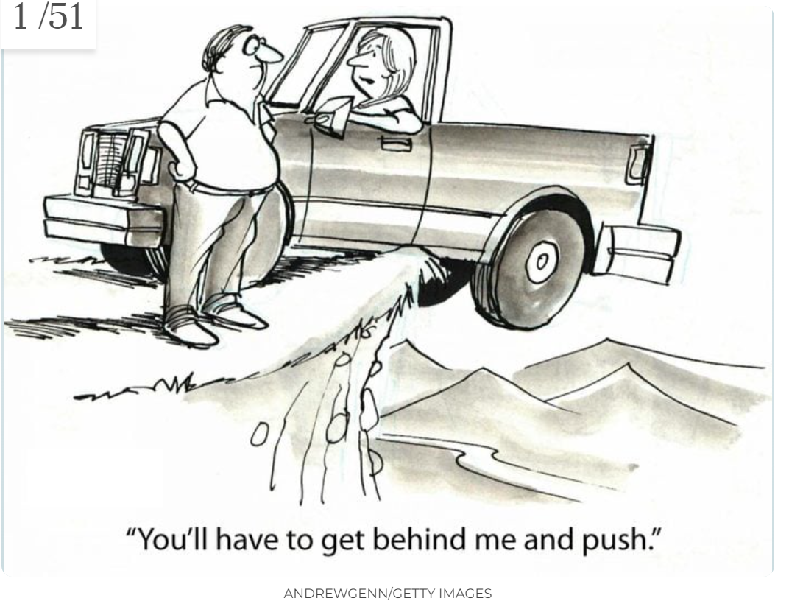

Slide 22
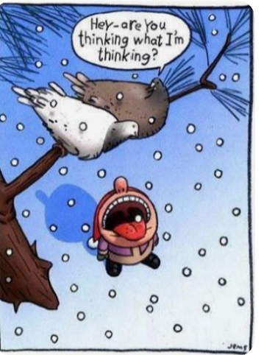

Slide 24
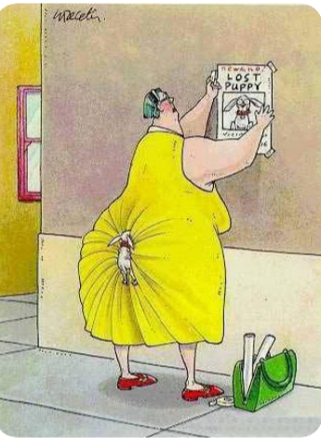

Slide 25
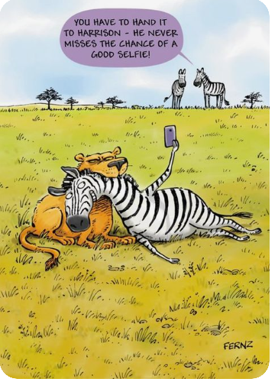

Slide 26
