Slide 1
Teach2Give Leadership Retreat
Session 2 – Basic Mentoring Techniques

Slide 2
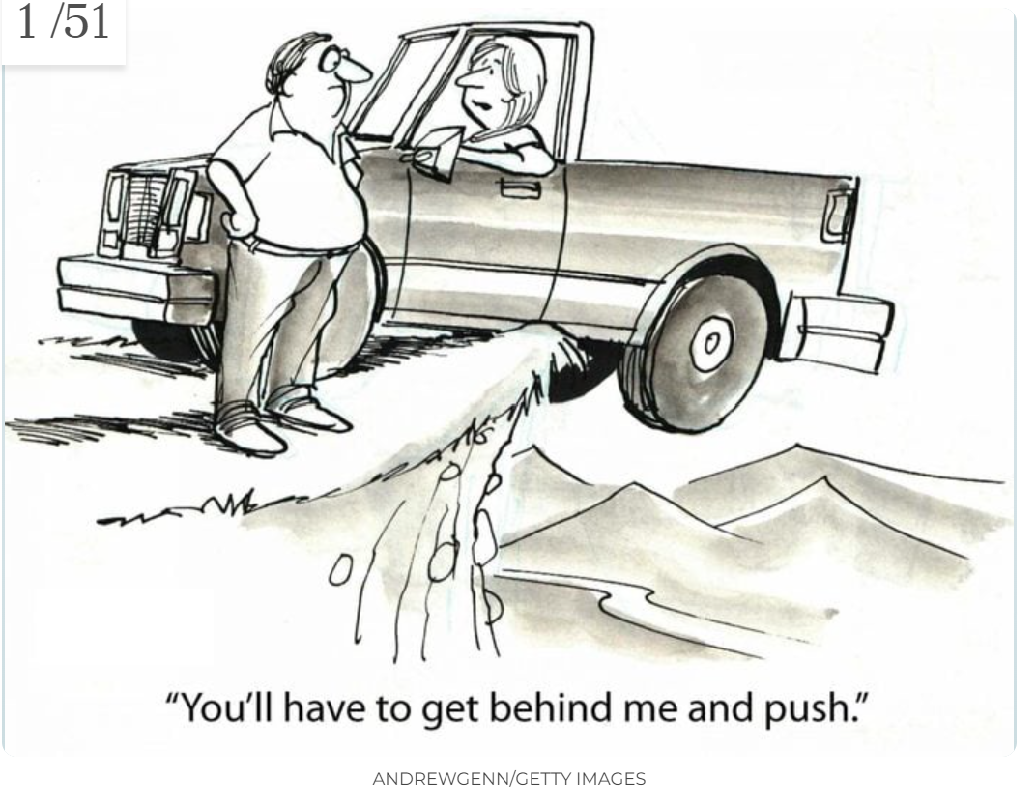
Basic Do’s & Don’ts of Mentoring

Slide 3
Don’t
Mini Me
”You should _____”
You Are Not Their Manager
Situational Leadership
Take Ownership
Feel Guilty
Runaway Time

Slide 4
Do
Personal / Relational / Safe
Feedback
Ask Good Questions
Dignity
Be Prepared
Assign Homework
Provide Feedback

Slide 6
Summary
Have Humility
Build Them Up
NOT Build YOU Up
Practice

Slide 7
Situational Leadership: Role Play
Goal: Getting the mentee to think is more important than getting them to do
The should do’s
Use Handouts

Slide 8
Situations
Example 1: Mentee gets a poor grade on an assignment
Example 2: Mentee has a goal to be better at public speaking
Example 3: Stages of Competency-Assess Competency
Example 4: Building Personal Relationships
Example 5: Feedback

Slide 9
Assignment
Discuss with your mentor- how can they help you?
Anything you learned today that you were unaware of before?
Things about being a mentor you’d like to review with your mentor each month?
Write out a brief plan to discuss with your mentor (3-5 sentences)
Write down thoughts and questions for your mentor AFTER you’ve met with your mentee.
How can you improve
Where there responses you didn’t know how to respond to?

