Slide 1
Teach2Give Leadership Retreat
Session 3 – Cohort Mentoring Curriculum

Slide 2
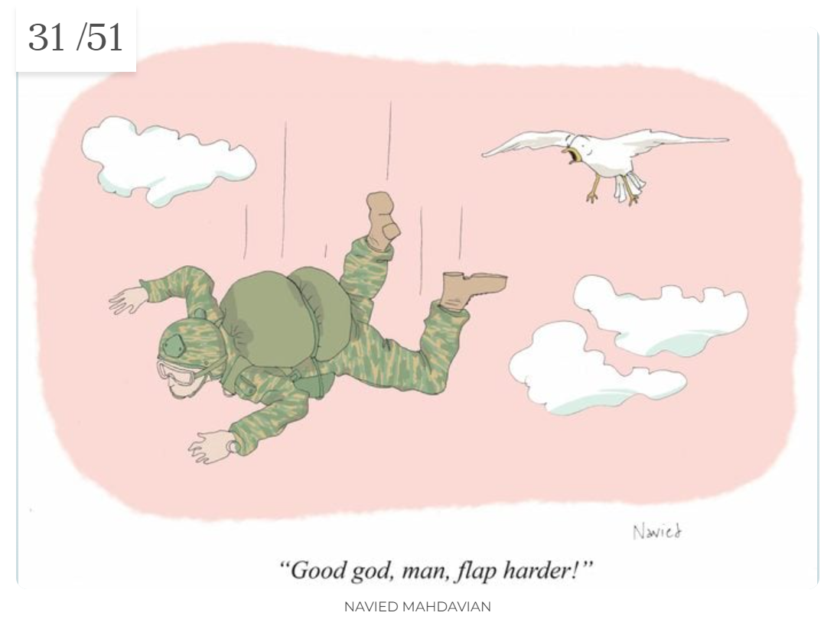

Slide 3
Don’t Wing It
Know The Goal
Novices Should Use Instructions
Provide Feedback on Curriculum
Use Curriculum with YOUR Mentor
Keep Notes
Plan
Record
Next Session Action

Slide 4
12 Weeks
6 Sessions
First Semester
Review with your mentor monthly
Subsequent Semesters
Meet with your mentor quarterly
Push

Slide 5
Teach2Give.com
Mentor Documents
Cohort Mentoring Curriculum
Each Session
Objective
Homework Review
Discussion Suggestions
Assignment
Combine sessions if missed

Slide 6
FAQ: Religion
Can You Discuss?
How Can You Bring It Up
What Do’s / Don’ts Apply

Slide 7
FAQ: Soft Skills
Tell Me About Yourself
Why Should We Hire You
What Do’s/Don’ts Apply

Slide 8
FAQ: Continuing Education
What Follow-up Questions

Slide 9
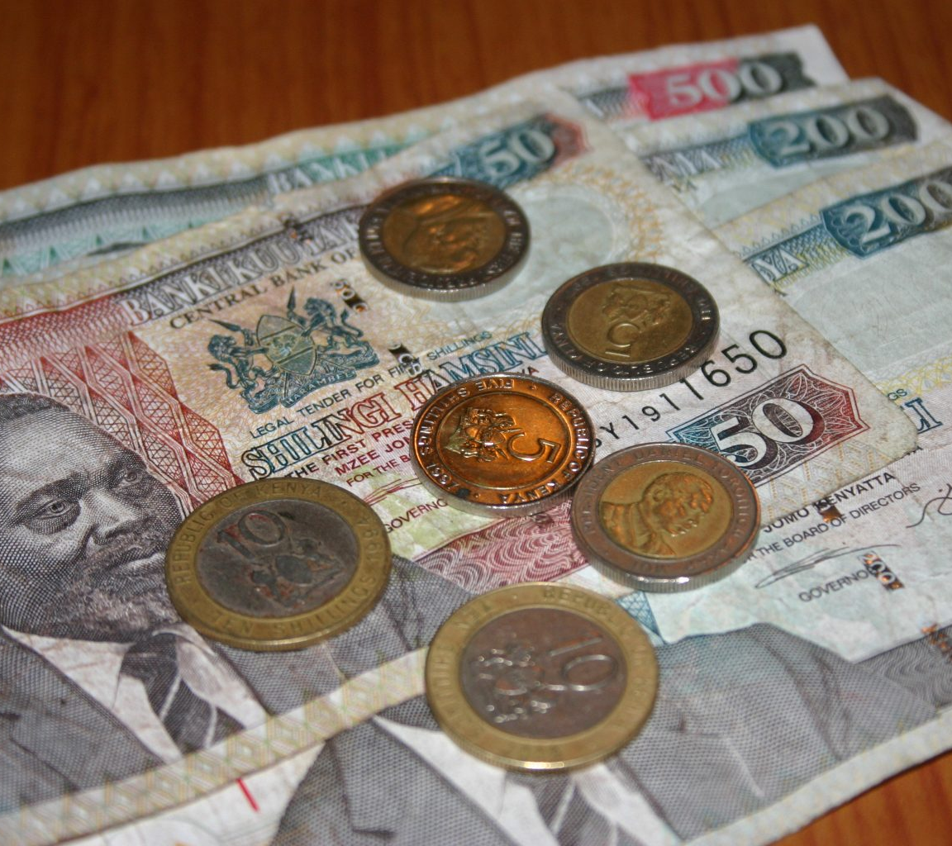
FAQ: Finances
Help
Budget
Priorities
Debt

Slide 10
Group Activity
What a woman says:
Cmon…This place is a mess! You and I need to clean. Your pants are on the floor and you’ll have no clothes if we don’t do laundry now!
What a man hears:
C’MON….blah, blah, blah YOU AND I blah, blah, blah, blah, blah ON THE FLOOR blah, blah, blah, NO CLOTHES blah, blah, blah, blah, NOW!

Slide 11
1. Drawn Understanding- comprehension and communication

Slide 12
2. Open and Close Ended Questions
One of the best skills is to practice the open and closed question. Makes conversations precise and helpful.
Mentors ask mentees to share their concerns or goals with a few open ended questions.
Answer with a few closed ended questions for clarity

Slide 13
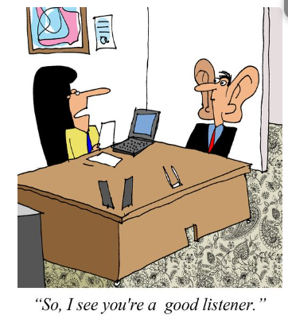
3. Table Topics
Short conversation starters on the job

Slide 14
4. Mock interviews-practice critical thinking, self confidence

Slide 15
5. Situational mentorship- responses
All participants will write down solutions to the different scenarios. Therefore, it is better to make the participants work in teams. As a mentor, how will you respond? How will you help them realize their mistakes
Got a bad grade
For each
Unconsciously incompetent
Consciously incompetent
Consciously competent
Unconsciously competent
Beginning personal project
Developing a plan for the personal project
Identify completion milestone
How do I talk about myself for 5 minutes
How do I tell someone why they should hire me

Slide 16
6. Feedback sandwich Role play - practice positive feedback

